Slide 1
CNA Gate2 SOLUTION ARCHITECT LEARNING INTERVENTION Group 1
Arun Sridhar, Sathish Raghavan, Sailalitha Dharmaraju, Vijay Karthik Nagarajan

Slide 2
CASE 1 - Brooks Brothers – requirements
Brooks Brothers is a renowned apparel brand and one of the oldest in America that produces clothing for men, women and children, as well as home furnishings.
Problem statement –
Brooks Brothers wants to implement a new CRM system on their existing technology platform.
The company is also looking to solve the following problem areas in their current technology landscape.
Improved agility in quickly delivering solutions to fast-changing customer needs
Ability to quickly test new concepts and deploy to production
Better scalability to meet growing global market needs
Key asks for the solution –
Security
Cost effective
Integration with current platform
Designing Basic CRM that Includes following
Customer Registration
Lead tracing and capturing potential customer
Issues Handling
Features to view the bills and payments

Slide 3
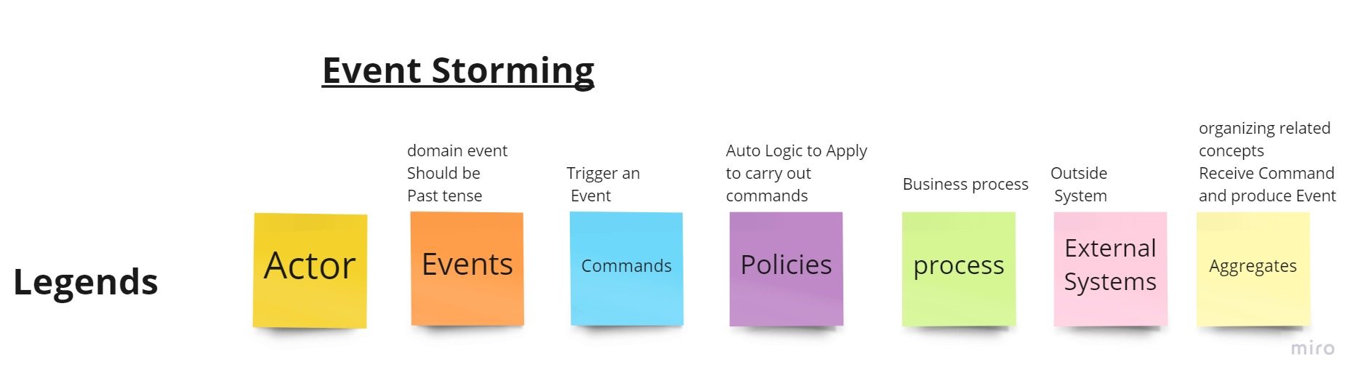
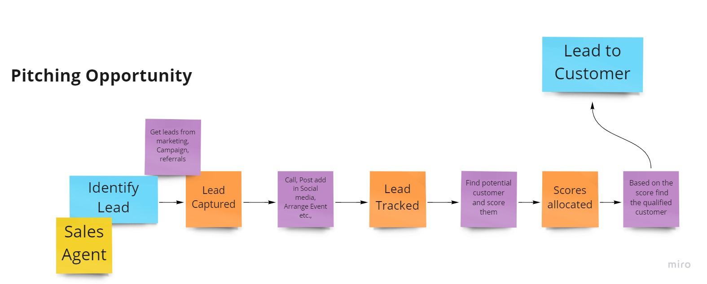
Brooks Brothers – Event storming

Slide 4
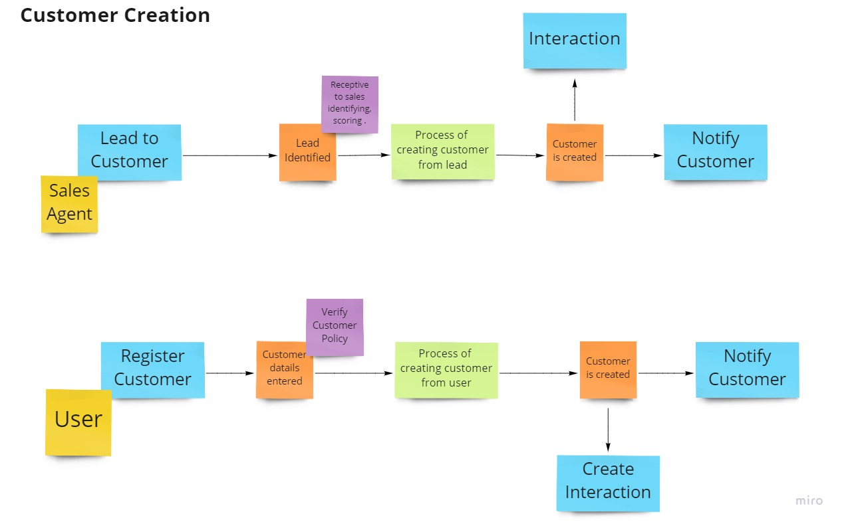
Brooks Brothers – Event storming (contd)

Slide 5
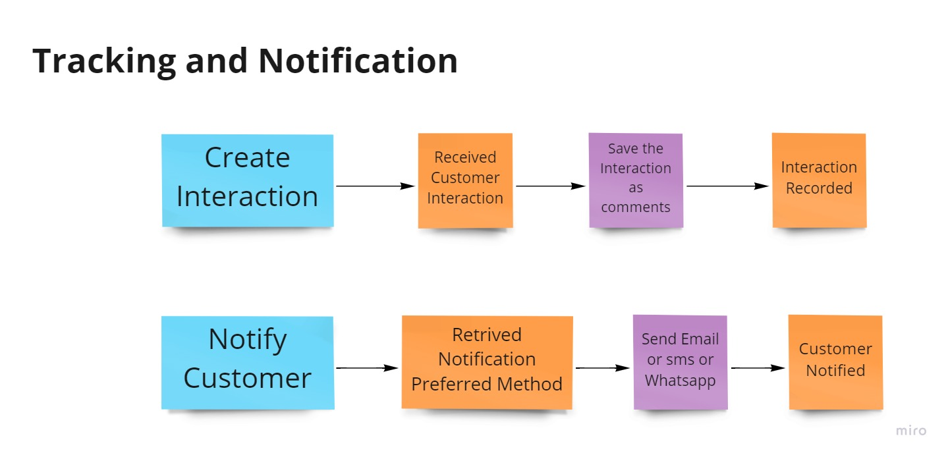
Brooks Brothers – Event storming (contd)

Slide 6
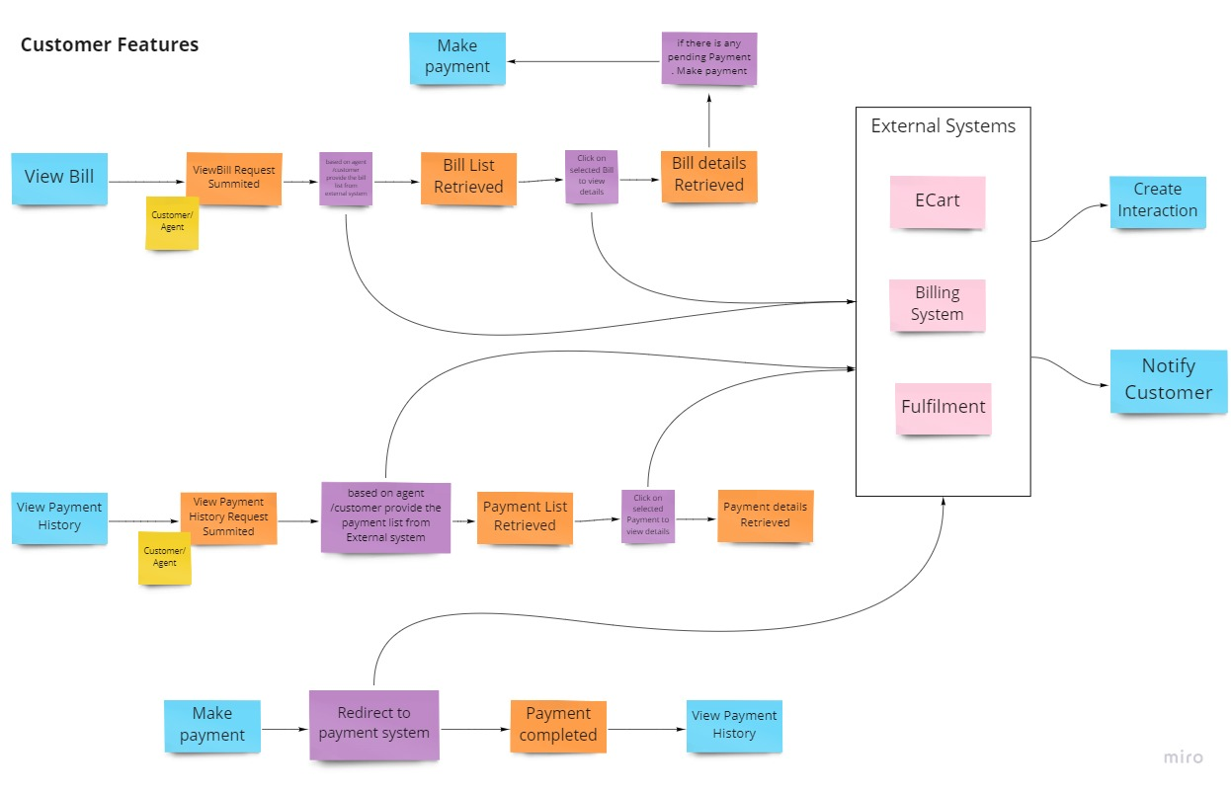
Brooks Brothers – Event storming (contd)

Slide 7
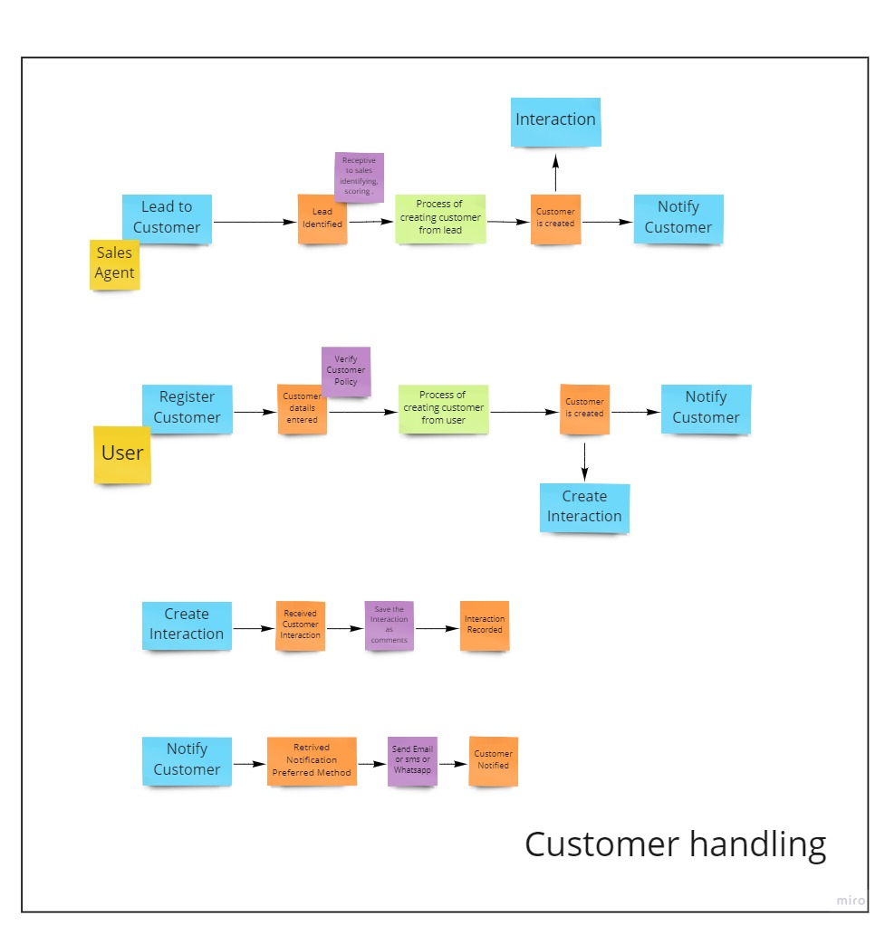
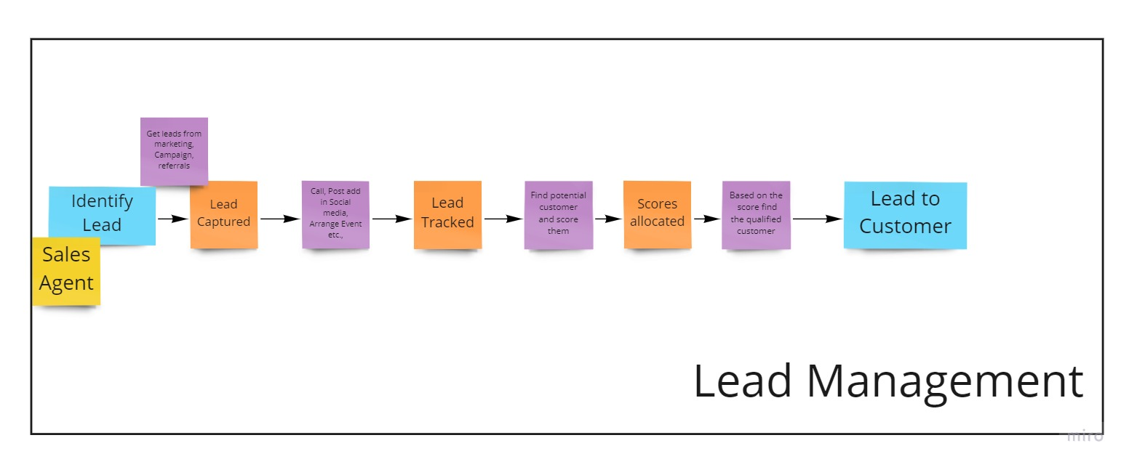
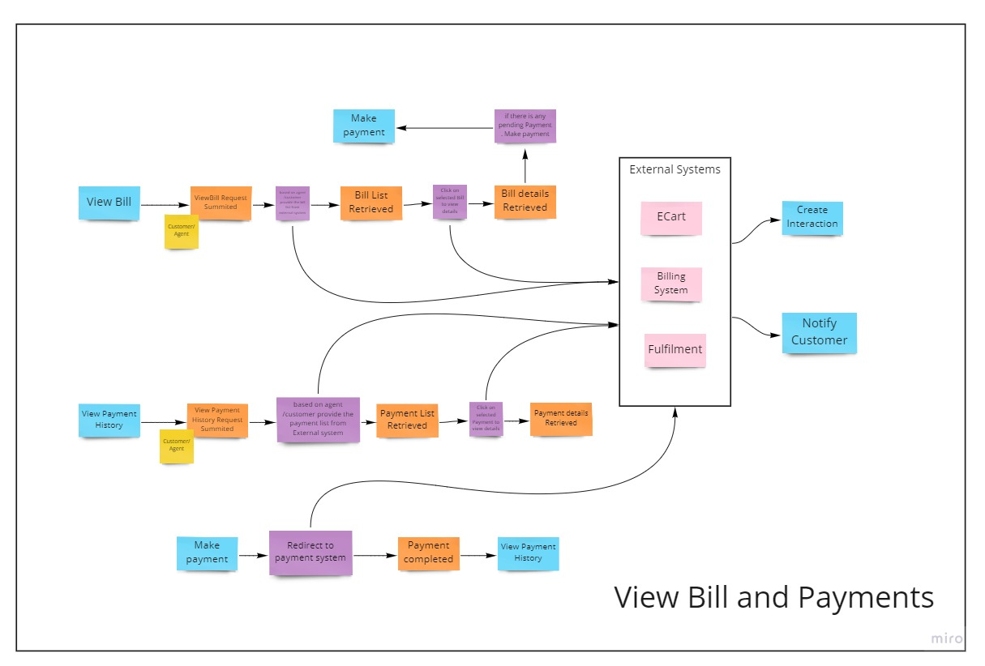
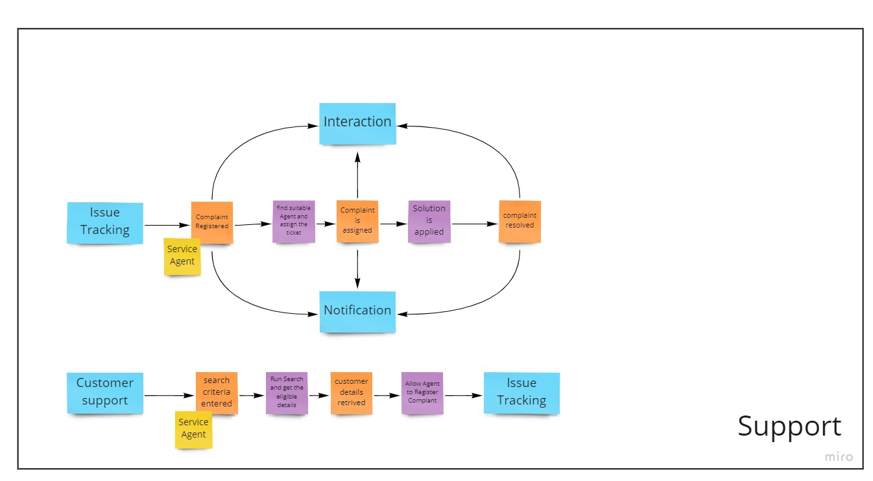
Bounded Context

Slide 8
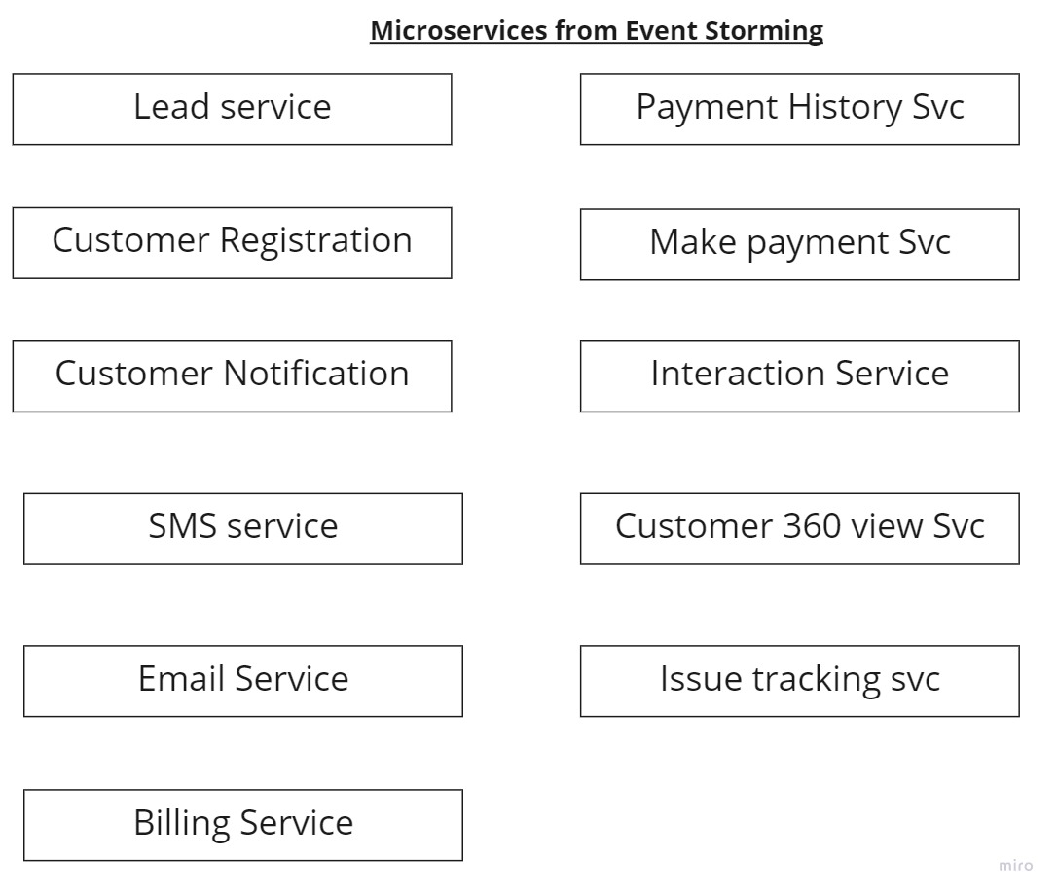
Brooks Brothers – solution – microservices

Slide 9
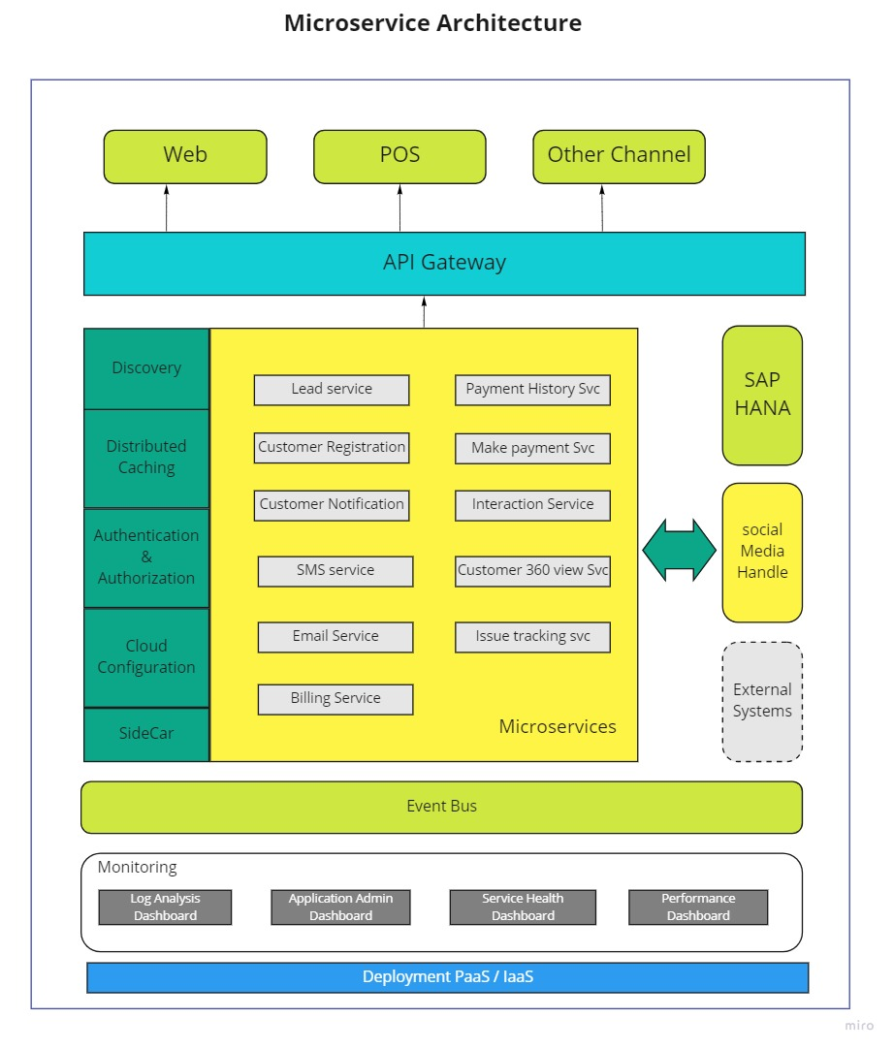
Brooks Brothers – Proposed solution

Slide 10
Brooks Brothers – solution – microservices
How would you deal with Messaging in microservices ?
We will use event bus using high speed pub-sub like Kafka to process domain and business events in the above architecture
Integrating Microservices (Inter-service/process Communication) ?
For synchronous calls - We will use REST based API with Identity Service(OAUTH2) for inter service communication.
For asynchronous calls - We will use event driven architecture using event bus (high speed pub-sub messaging like Kafka)
Design Patterns
DB per bounded context
API Gateway
Saga
Event Sourcing
Externalize configuration
Observability

Slide 11
Case 2 – COursera – requirements
Coursera is a leading educational technology company that provides online courses to users across the world.
Problem statement –
Challenges in trying to migrate monolithic batch job processing application to containerized microservices using Docker and Mesos.
Lack of expertise in Mesos within the organization to handle the complex set up.
Need to invest high cost and time on the infrastructure management issues.
Key asks for the solution –
Efficient use of computing resources
Resource isolation of each batch job as each has different resource requirements
Eliminate the need for investing time and resources in building expertise in managing infrastructure issues.

Slide 12
Coursera Architectural Diagram
EXTERNAL SYSTEMS
CLOUD VAULT
FIREWALL
BLOB STORAGE
BATCH CONTROL SYSTEM
BATCH JOB 1
BATCH JOB 2
BATCH JOB 3
BATCH JOB 4
CMS
CLOUD MONITORING/TELEMETRY
DATABASE
PUBLISHER SUBSCRIBER

Slide 13
Coursera – solution – microservices
Solution Recommendations
Containerized microservices for each batch job to achieve efficient resource management, isolation and scalability.
Cloud services for infrastructure management (cluster management, orchestration) to reduce the investment of cost and time to build the required competencies.
How would optimize jobs that involve more processing logic and consume more resources?
We can use Work queue or MapReduce patterns to improve efficiency of batch jobs that require extensive processing and resources.
How would you handle secure operation on cloud?
Using secure certificate vault on the cloud.
Design Patterns
Single node containers
Work queue
API Gateway
Externalize configuration
Observability
Strangler Application
Messaging
Service instance per Container

